Slide 1
<Test Phase>Test Plan
<Project Name>
<Project id>

Slide 2
Document History
Document Information
Document Name | <Project Name> <Test Phase> Plan Document
Status | Draft/ Signed-off
Date Last Edited | 10/01/2017
Document Author | <Author Name, Test Manager>
File URL
Consulted with
Version | Name | Role | Date
 |  | <Project Manager>
 |  | <Test Environment and Data Practice Team>
Version History
Version | Revision Date | Updated by | Summary of Changes
Sign-off
Version | Name | Organisation/Role | Date
 |  | <Application Owner>
 |  | <Technology Delivery Lead>
By signing off, the sign-off parties acknowledge that they are signing-off the Test Strategy based on the risk appetite of technology and the business.
<Attached Sign-off Email Here>
Supporting Documents/ URL
Version | Document Name | URL
 | <Test Strategy Document>

Slide 3
Contents
Introduction
In-Scope Applications and Functions
Out of Scope Applications and Functions
Test Approach
Testing Techniques
Test Phase Exit Criteria
List of Deviations from the Test Strategy
Test Environment
Test Data
Test Responsibilities
Test Schedule
RAID Log
References
Appendix

Slide 4
1. Introduction
Purpose
The purpose of this document is to outline the detailed testing plan for <Testing Phase> of <Release/project>.
Project / Release Overview
<Provide a brief overview of the project/release. This should be consistent with the Test Strategy>
Notes:
The text

Slide 5
2. In-Scope Applications and Functions
The following table lists the applications and functions that will be tested and provide the location for placing test evidence.
Application Name | Functions | Sub-Function | Location of Test Evidence
<Application 1>
<Application 2>
<Application 3>
<Application 4>

Slide 6
3. Out of Scope Applications and Functions
The following table lists the applications and functions that will NOT be tested.
Application Name | Functions | Sub-Functions | Reasons
<Application 1>
<Application 2>

Slide 7
4. Test Approach
The following table provides the execution approach that will be followed by application in each cycle. Highlight the focus for each test cycle. <For Non-Functional test phases, the table can be modified as required. You can specify the test types, business scenarios to be tested, expected results and approach to be followed to setup/conduct the these tests>
Application Name | Cycle 1 | Cycle 2 | Cycle 3 | Cycle 4
< Application 1> | <e.g., all in-scope functions will be tested in except XXX function> | <e.g., XXX function will be tested and retesting of defects> | <e.g., Regression cycle and retesting of defects> | <e.g., contingency cycle>
< Application 2> | <e.g., transaction setup for Application 3> | <e.g., transaction setup for Application 3 (if necessary)>
< Application 3> |  | <e.g., all in-scope functions using the transactions from Application 2> | <e.g., retesting of defects> | <e.g., Regression cycle and retesting of defects>
< Application 4>
< Application 5>

Slide 8
5. Testing Techniques
Specify the different testing techniques that will be carried out in this testing phase.
Refer to the SCB Detailed Testing Guidelines for the list of the different testing techniques.
Testing Techniques | Testing Techniques
1 | 13
2 | 14
3 | 15
4 | 16
5 | 17
6 | 18
7 | 19
8 | 20
9 | 21
10 | 22
11 | 23
12 | 24

Slide 9
6. Test Phase Exit Criteria
The following table provides the exit criteria for this test phase.
Refer to the SCB Detailed Testing Guidelines for the list of exit criteria.
Exit Criteria
1
2
3
4
5
Notes:
For Non-Functional test phases, the table can be modified as required.
Example:
1) Performance Test - Specify the business scenarios to be tested, expected results and approach to be followed to setup/conduct the these tests.
2) Failover and Recovery Test – List the Switch Over, Functional Verification and Switch Back test scenarios. Specify the approach to be followed to setup and conduct the these tests.
3) OAT – List the test scenarios in-scope and the expected results.
Specify the approach to be followed to setup and conduct the testing for identified test scenarios.

Slide 10
7. List of Deviations from the Test Strategy
The following table provides the list of deviations from the signed-off Test Strategy.
Deviation Type | Deviation Details | Dispensation Approval
Tools | <e.g., JIRA will be used instead of HPALM> | <dispensation not required>
Test Environment | <e.g., UAT will be conducted in same environment as SIT due to unavailability of UAT environment as scheduled> | <JIRA ID/ link>
Test Approach | <e.g., for SIT, instead of using interfacing application3, service virtualisation will be used> | <dispensation not required>
Entry Criteria
<Add more rows as required>

Slide 11
8. Test Environment
The following table specifies the details of the test environment/s to be used for this test phase.
Application Name | Test Environment | Dedicated Or Shared | Available From | Available Until | Provisioned By
<Application Name> | <e.g., DB Server IP: Application Server IP:> | <‘D’ or ‘S’> | <Date> | <Date> | <Include the team/contact who will provisioned the environment>

Slide 12
9. Test Data
The following table specifies the test data required for this test phase.
Application Name | Test Data | Available From | Provisioned By
<Application 1> | <Include Data requirements> <e.g., Use production data (masked); approval obtained> | <Date> | <Include the team/contact who will provisioned the data>
<Application 2> | <e.g., Create new data for customer accounts and transactions> | <Date> | <Include the team/contact who will provisioned the data>

Slide 13
10. Role and Responsibilities
Specify the responsible team/role for the key activities for this test Phase. This should be aligned to SDF.
Key Activities | Responsible Role or Team | Primary Contact Name(s) | Escalation Contact Name(s)
Create, Publish and Maintain Test Plan | <e.g., E2E/Test phase Test Manager>
Create Test Scenarios and Cases | < e.g., Testing Teams>
Update Traceability Matrix | < e.g., Testing Teams>
Ensure Readiness of Test Environment | < e.g., Test Environment Teams>
Verify Test Data | < e.g., Testing Teams>
Conduct Test Kickoff Meeting | <e.g., E2E/Test Phase Test Manager>
Deploy software to Test Environment | <e.g., Application Development Teams>
Execute Test Cases | < e.g., Testing Teams>
Fix Defects | <e.g., Application Development Teams>
Prepare Test Reports | <e.g., E2E/Test Phase Test Manager>
Obtain Test Signoff | <e.g., E2E/Test Phase Test Manager>

Slide 14
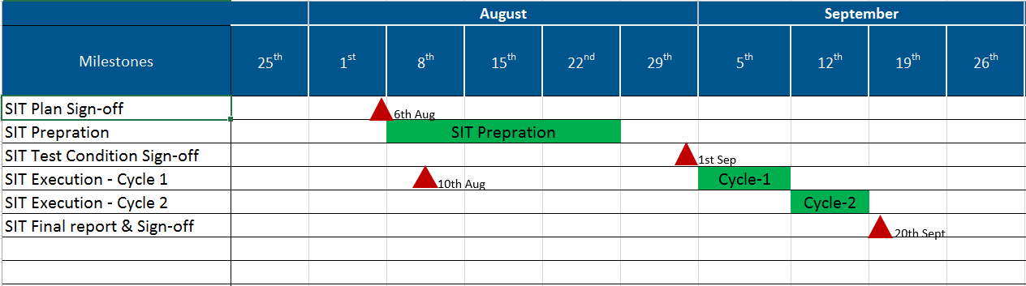
11. Test Schedule
Specify the test schedule. Use the attached spreadsheet to create the schedule and paste a snapshot below (see example).

Slide 15
12. RAID Log
The following table lists the risks, assumptions, issues and dependencies for this project.
Phase of Item | Description | Severity | Impact | Mitigation Plan
<Risk> |  | <High/Medium/Low> | <specify how risk Impacts the product/release>
<Assumption>
<Issue>
<Dependency>

Slide 16
13. References
Reference Document | Link/URL
<Test Phase> | <Link to the test phase document >

Slide 17
Appendix
<Please add any other relevant information in this section>

